Slide 1
SINGLE VALLEY Basis
The basis states generalized to the effect of operators and rotated to other valleys

Slide 2

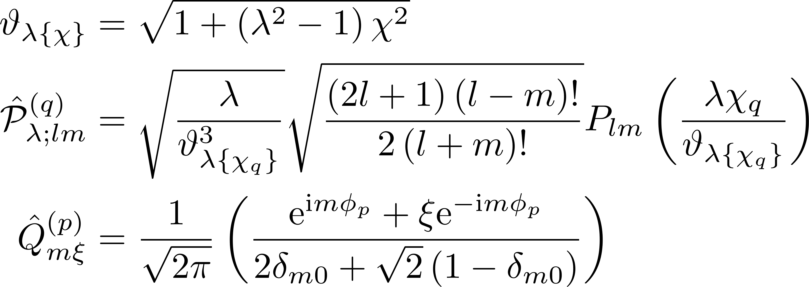

Generalized single-valley basis states

Slide 3
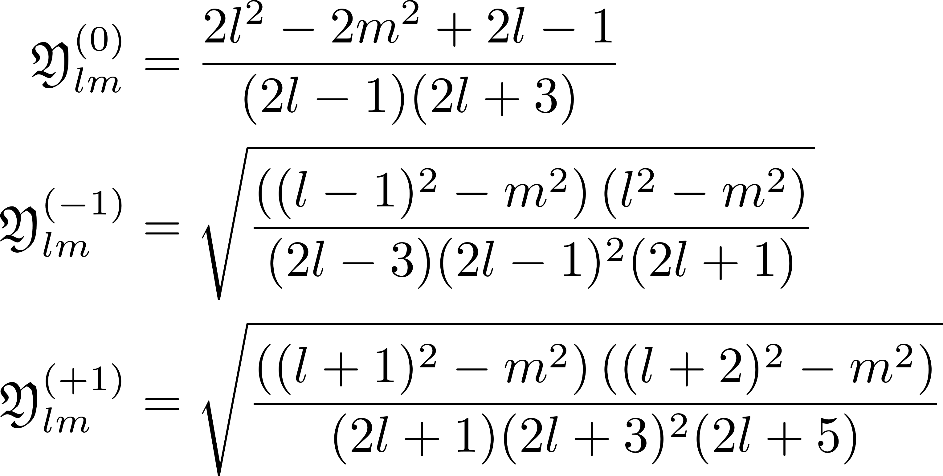


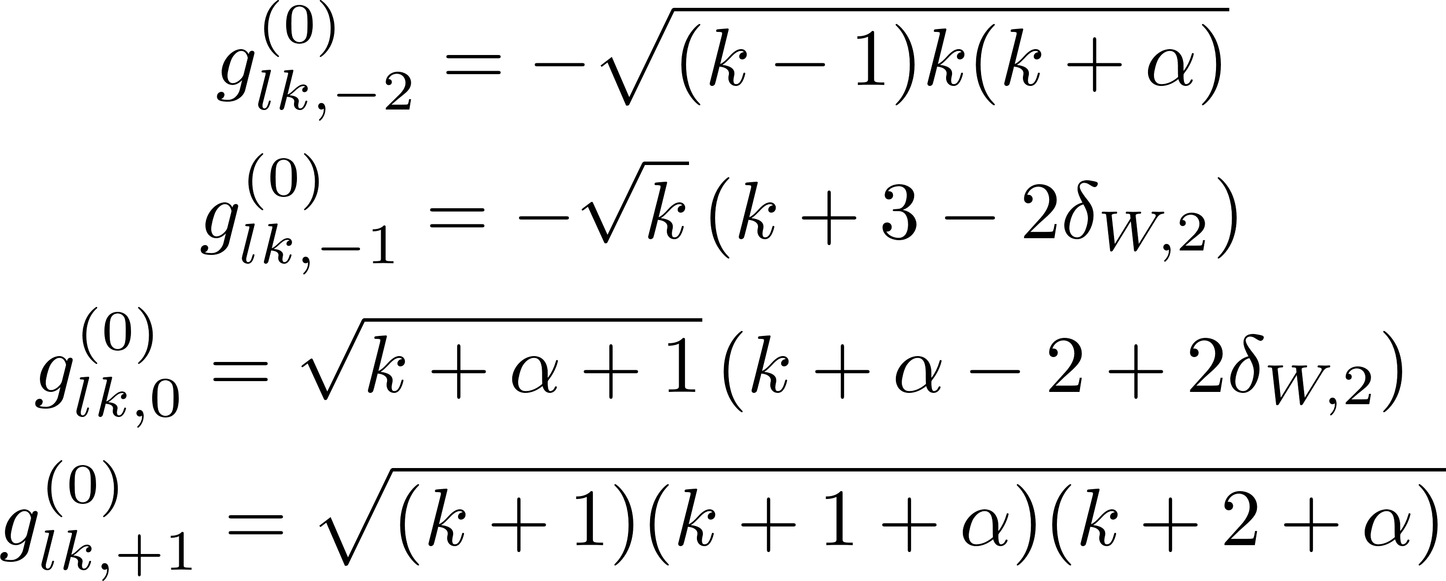
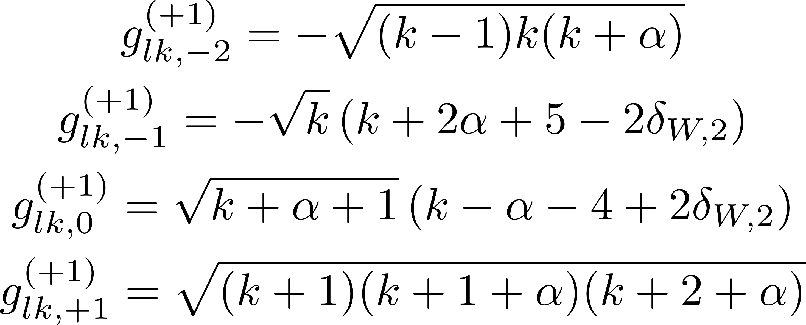


Generalized single-valley basis states

Slide 4
Integrable Potentials
Forms that might be used

Slide 5

Form of integrable potential

Slide 6
Same SubBasis MATRIX ELEMENT FORMULA
Finding a form for the matrix element of two states from the same subbasis

Slide 7
PRECALCULATIONS

Slide 8
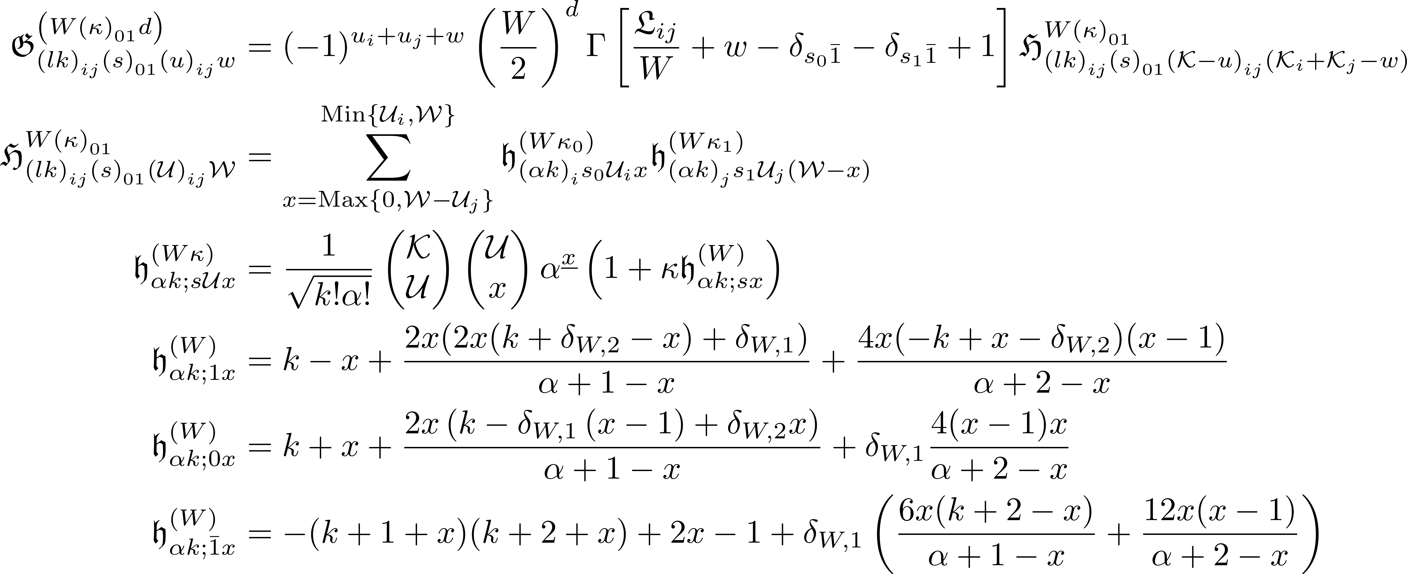
C1. Laguerre polynomial precalculated integration constants

Slide 9



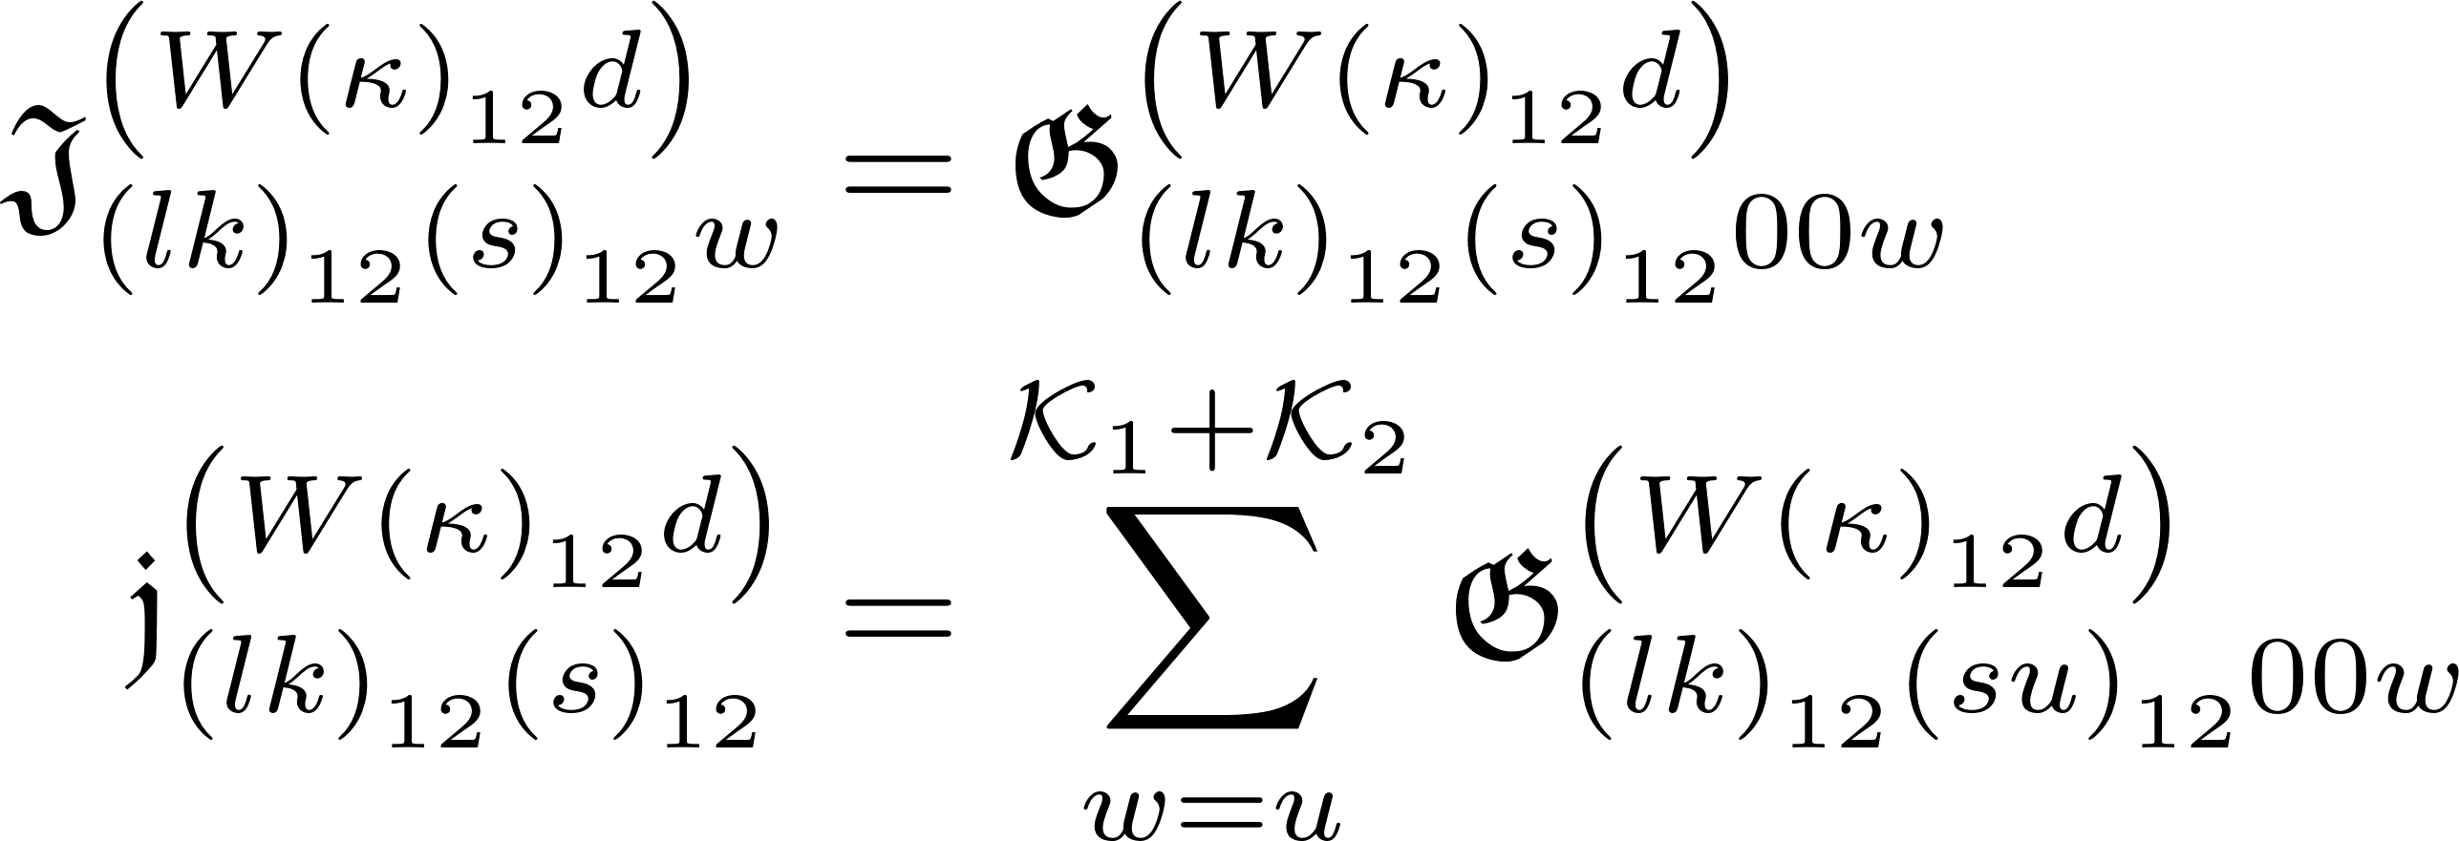
C2. Subcases

Slide 10

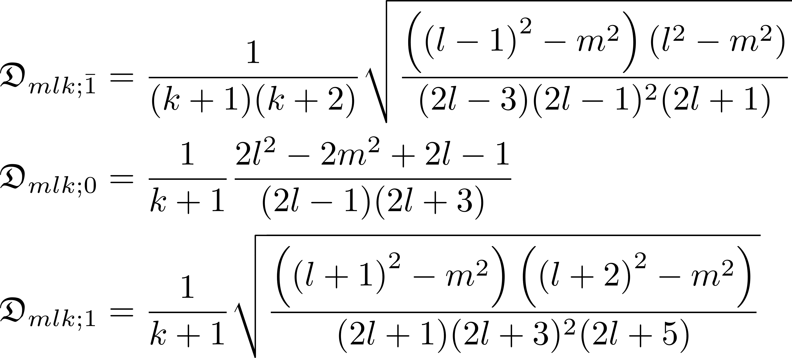
C3. Final elaboration on precalculation information - 2

Slide 11
Computational FormulAe

Slide 12

D1a. Before integration calculations

Slide 13


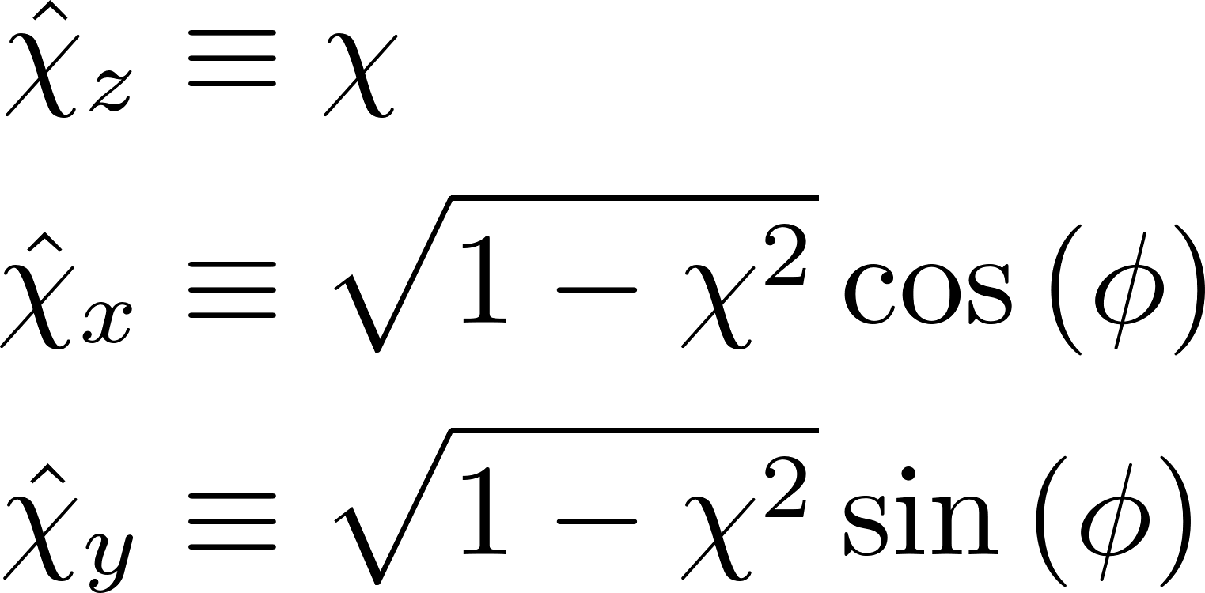

D1b. Initial integration calculations

Slide 14

D2. Full integral formalized

Slide 15
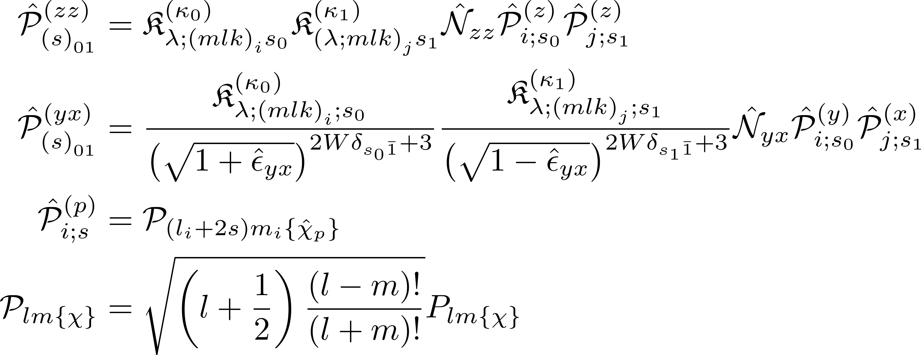
D3. Legendre functions for integrand

Slide 16



D4. Integral summation term restated

Slide 17

D4a. Integral summation term restated (Δ != 0, z != 1)

Slide 18



D4b. Integral summation term restated (Δ != 0, z = 1)

Slide 19


D4c. Integral summation term restated (Δ = 0, z != 1)

Slide 20


D4d. Integral summation term restated (Δ = 0, z = 1)

